Slide 1


WELCOME TO
YEAR 5

Slide 2
About me
About me
Miss Webster
This is my 6th year in Year 5 but I’ve worked here a very long time!
I’ve been involved in lots of things over the years but at the moment I’m the maths leader, LP and staff governor.

Slide 3
Staffing:
Teachers
Miss Webster, Miss Worthington
Mrs Balmer
Teaching assistants
Miss Jones and Miss Robinson

Slide 4
Staffing: Further Support
Phase leaders
Mrs Lees
Head teacher
Mrs Fry
Pastoral
Mrs Lockett
SENCo
Mrs Balmer

Slide 6
Daily Routines
A healthy snack can be brought in from home or purchased from canteen.
Water bottle every day
Break times - activities available on playground
Quiet Club – for children with specific needs
Midshires - Lunch menu/ arrangements - Tasting menus available in the hall
Notes:
Explain that children will be discouraged from accessing their water bottles during teacher inputs.

Slide 7
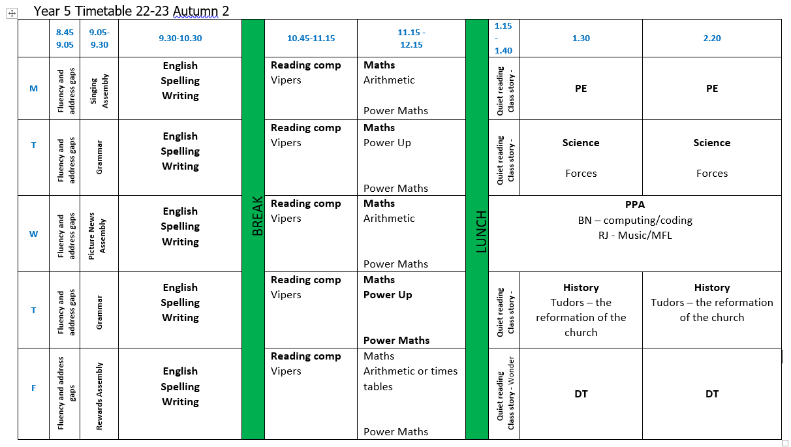

Slide 8
Year Group Readiness
In Year 5, we promote a high level of independence and support children with gaining a level of maturity needed for Year 6 and high school.
Children are encouraged to be responsible for their own belongings, their home work and their learning in the classroom.
Assessment
Information relevant to your year group e.g.
Phonics – if required
Reading fluency
NTS termly assessments
This informs how we structure the support.
Notes:
What we expect of children in that year/what they need to be able to do and ways to help at home.
E.g.
Y3 might talk about the importance of becoming more independent and being able to get changed quickly in preparation for their swimming lessons. You might also talk about the Times Tables Test in Y4 and how they can start to help prepare their children while they are in Y3.

Slide 9
PE Days
Please can you name ALL uniform and All PE Kits.
Kits must stay in school and will be sent home each half term.
PE will be taught for 1 lesson on a Wednesday and for 1 lesson, by a PE coach from ‘Activities for All’, on a Thursday afternoon.

Slide 10
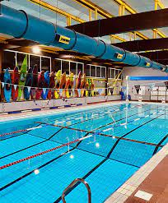
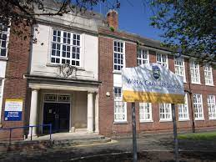
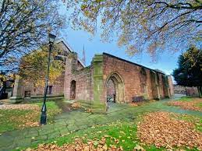

Trips and Visits

Slide 11
Communication
Arbor Comms
Twitter
Open evenings
Email/call/come in to speak to staff - teacher, phase leaders, headteacher
Parents evenings
Reports
Support Plans for SEND
Coffee mornings
Parent surveys
Staff on gates
Certificates
Message home
Week ahead
Weekly news

Slide 12
Homework/ parental support
Homework expectations – under development following the Homework survey
Reading - phonics
Parent reading volunteers (can sign up in the hall)
Parent helpers
Twitter etc (can sign up in the hall with AS)
Parent Gov vacancy (will be advertised in Sept)

Slide 13
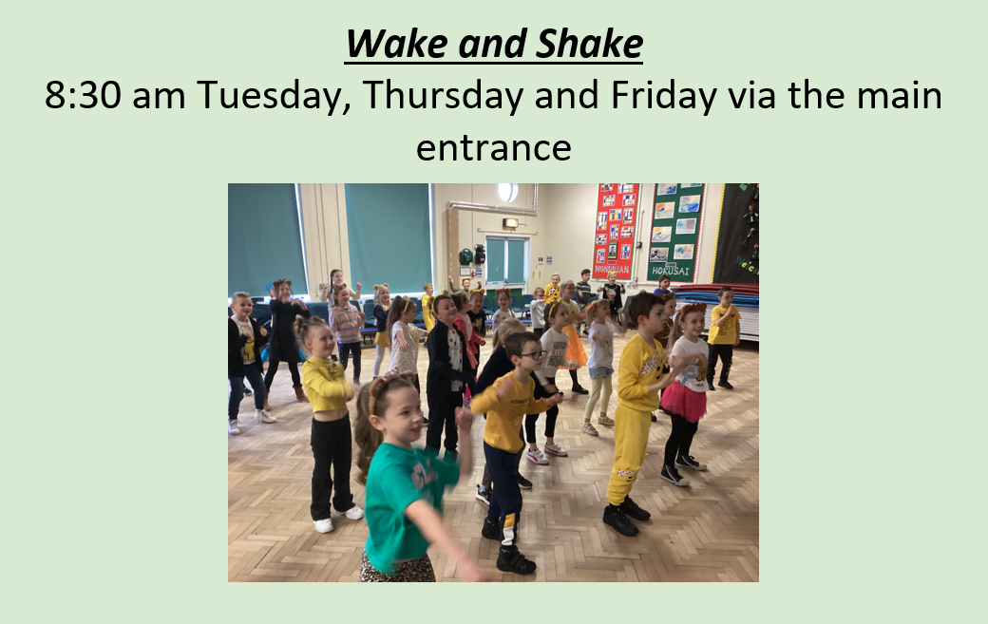
Extra-Curricular Activities, Sports and Events

Slide 14


Slide 15


Slide 16
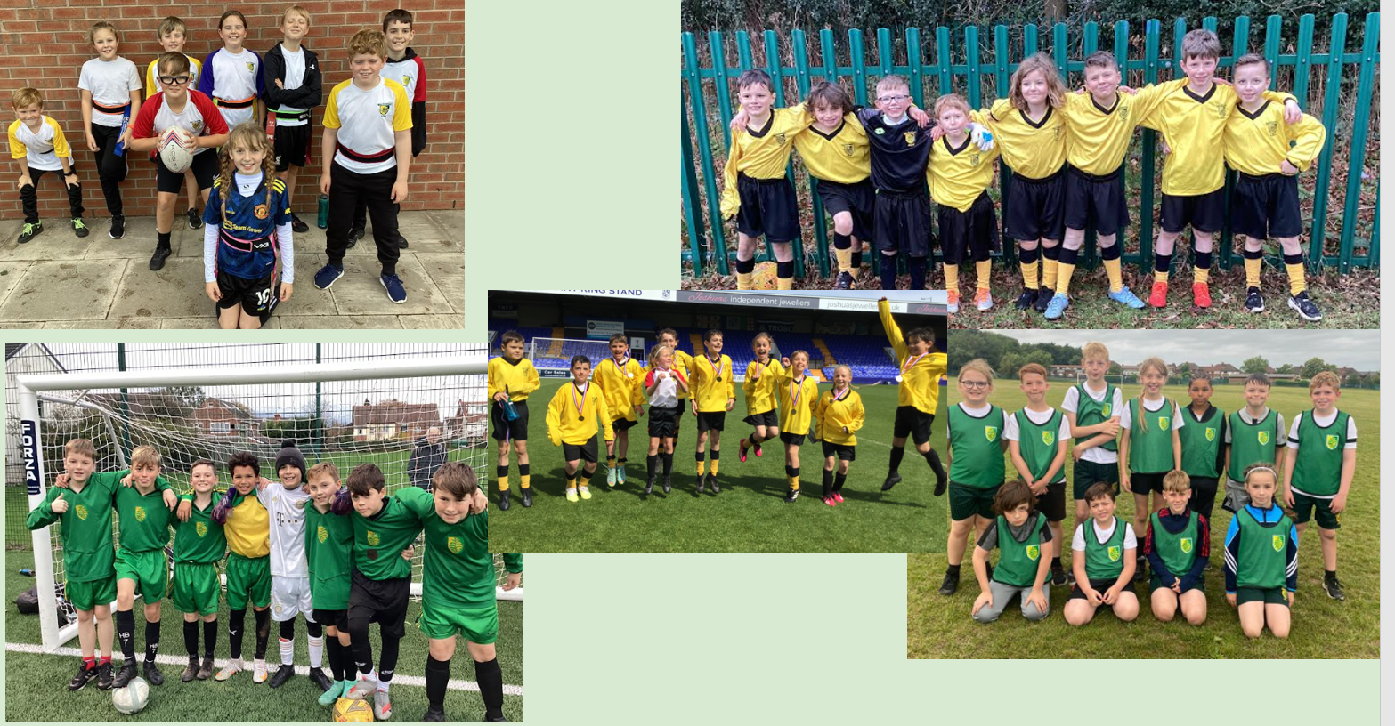

Slide 17
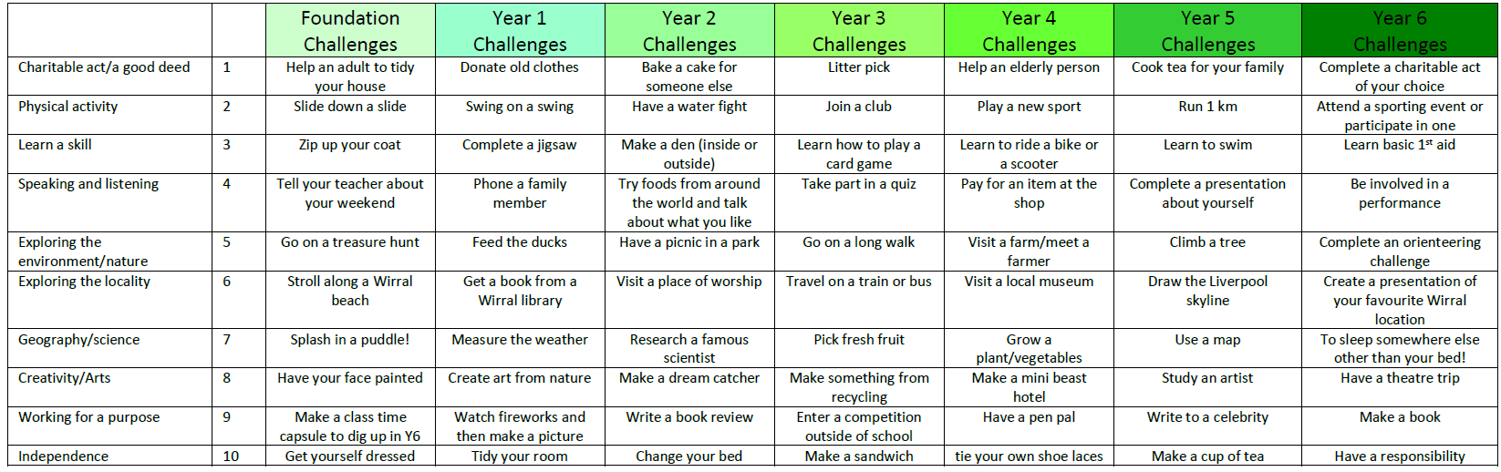
Oak Trees Challenge

Slide 18
Questions

