Slide 1
WELCOME TO
YEAR 4

Slide 2
Staffing:
Teachers: Miss McKinney, Mrs Kavanagh and Mrs Balmer
Teaching assistants: Mrs Case and Mrs Norman
Phase leader for Yr3/4: Mrs Balmer
Head teacher: Miss Fry
Pastoral: Mrs Lockett
SENCo- Mrs Balmer

Slide 3
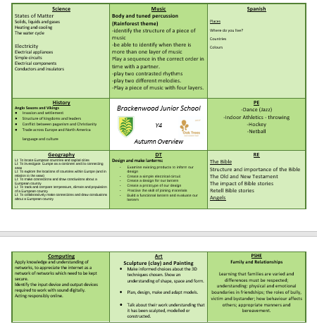
Our Curriculum
Notes:
Explain that this may be subject to change.

Slide 4
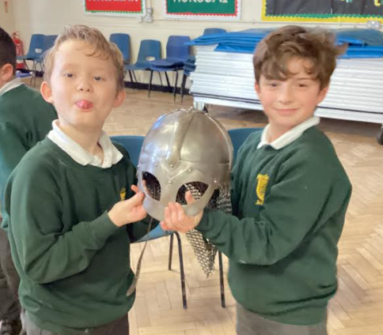
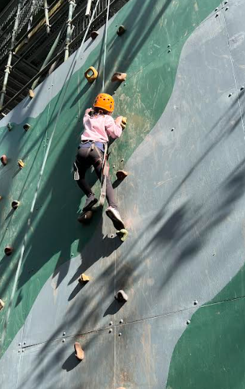
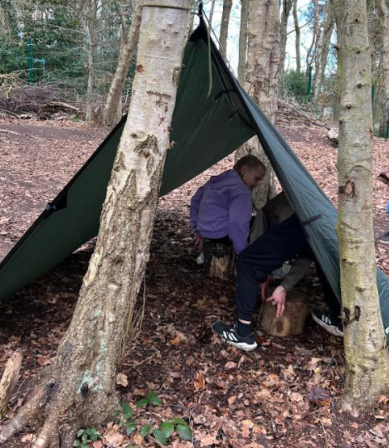
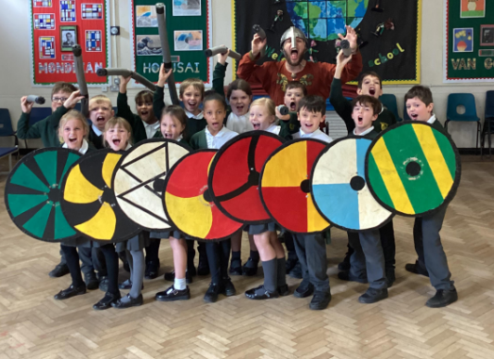
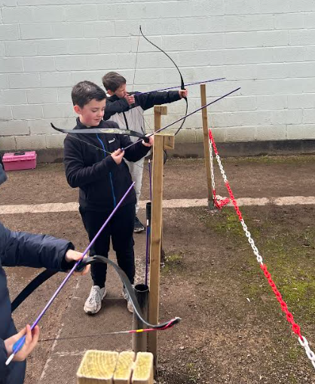
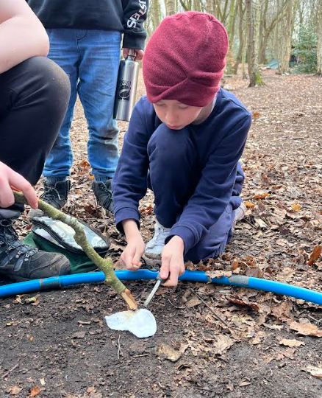
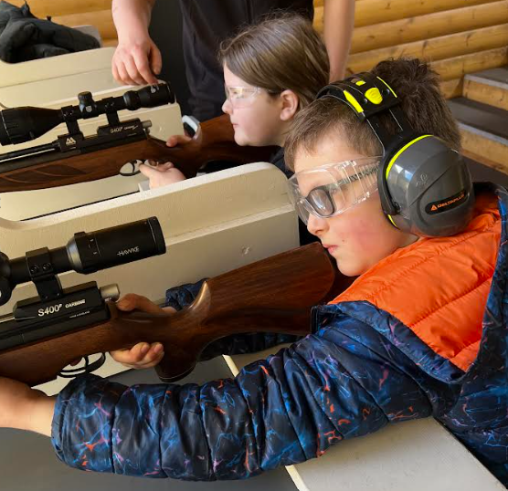
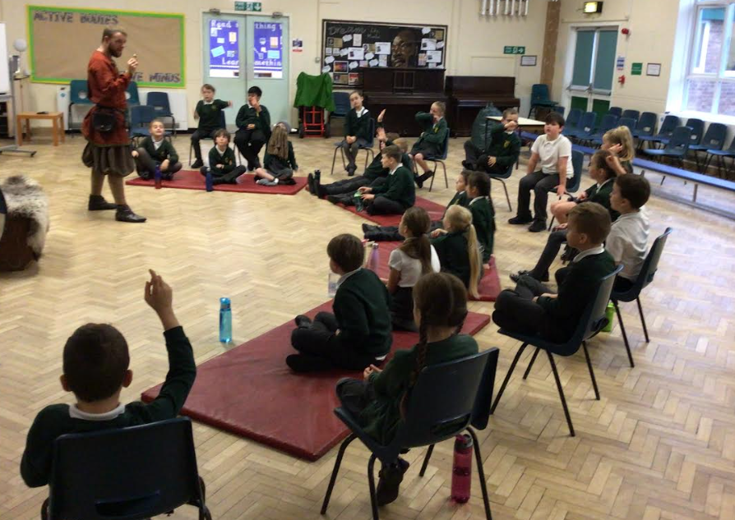
Trips and Visits
Viking Day in school and Barnstondale residential (March 2024)

Slide 5
Daily Routines
8.30- Wake and Shake open to all the hall via Main Entrance Monday, Tuesday, Thursday ad Friday.
8.45-9am- Registration and Morning activities.
Assembly (Mondays- picture news and Wednesday- Singing assembly) or Handwriting.
Morning of English, Maths and Reading.
Break- A healthy snack can be brought in from home or purchased from canteen. Year 3 and 4 will have a separate break time at 11am.
Lunch 12.15pm- Quiet Club, Sports Ambassadors lead a variety of playground activities along with a Sports Coach.
Quiet Club- accessible for children who struggle during unstructured times.
Afternoons- children will access a ‘brain break’ outside when weather permits.
Notes:
Explain that children will be discouraged from accessing their water bottles during teacher inputs.

Slide 6
Reminders
Your child should bring in a water bottle every day. These should be filled with Water only.
These will be kept at the back of the classroom and should be taken home each night. Children have access to their water bottles during the day.
We would prefer if children used a reusable plastic bottle.

Slide 7
Year Group Readiness
-Children need to remember and to take responsibly for their own equipment. For example, reading records, PE kits and water bottles.
Your child should bring in a water bottle every day. These should be filled with Water only.
These will be kept at the back of the classroom and should be taken home each night to refill with fresh water. Children have access to their water bottles during the day and can fill them up if needed.
We would prefer if children used a reusable plastic bottle.
- To be able to tell the time on a digital and analogue clock.
- Year 4 Timestables check- children need to be practicing daily both in school and at home.
Notes:
What we expect of children in that year/what they need to be able to do and ways to help at home.
E.g.
Y3 might talk about the importance of becoming more independent and being able to get changed quickly in preparation for their swimming lessons. You might also talk about the Times Tables Test in Y4 and how they can start to help prepare their children while they are in Y3.

Slide 8
Assessment
Children will be assessed in the first few weeks of Autumn Term to determine their reading ages and Phonics ability. From this, children will be given reading books appropriate to their ability.
Extra support may be given for children who require further phonics support through Read, Write Inc interventions.
Times Tables
Children will be tested weekly (Fridays) on their timestables each week. It is important children practice these at home either on TTRS or other useful sites.
Termly Assessment
Allows us to monitor progress and adapt our teaching for future lessons to ensure gaps are closed. Children are then identified if further support is required. These arke fed back through Parents evenings.
Children can also be put on support plans for their learning if we think they need further support which involve interventions.

Slide 9
PE Days
We will have 2 PE days next year- On Mondays and Tuesdays.
Monday’s PE day will be ran by a company called ‘Activities for All’.
PE Kit
-black trainers
-white top- this can be plain or with the Brackenwood logo on it.
-black trousers/black or green shorts/black leggings
-Black zip up jacket
Please ensure all clothing is named and the bag that they bring it in is named also.
We advise for children to leave their kits in school for the half term to ensure they don’t miss any lessons, however, if you wish to take it home please remember to bring it back in.

Slide 10
Communication
Arbor Comms
Twitter
Open evenings
Email/call/come in to speak to staff - teacher, phase leaders, headteacher
Parents evenings
Reports
Support Plans for SEND
Coffee mornings
Parent surveys
Staff on gates
Certificates
Message home
Week ahead
Weekly news

Slide 11
Homework/ parental support
Homework expectations – under development following the Homework survey
Reading - phonics
Parent reading volunteers (can sign up in the hall)
Parent helpers
Twitter etc (can sign up in the hall with AS)
Parent Gov vacancy (will be advertised in Sept)

Slide 12
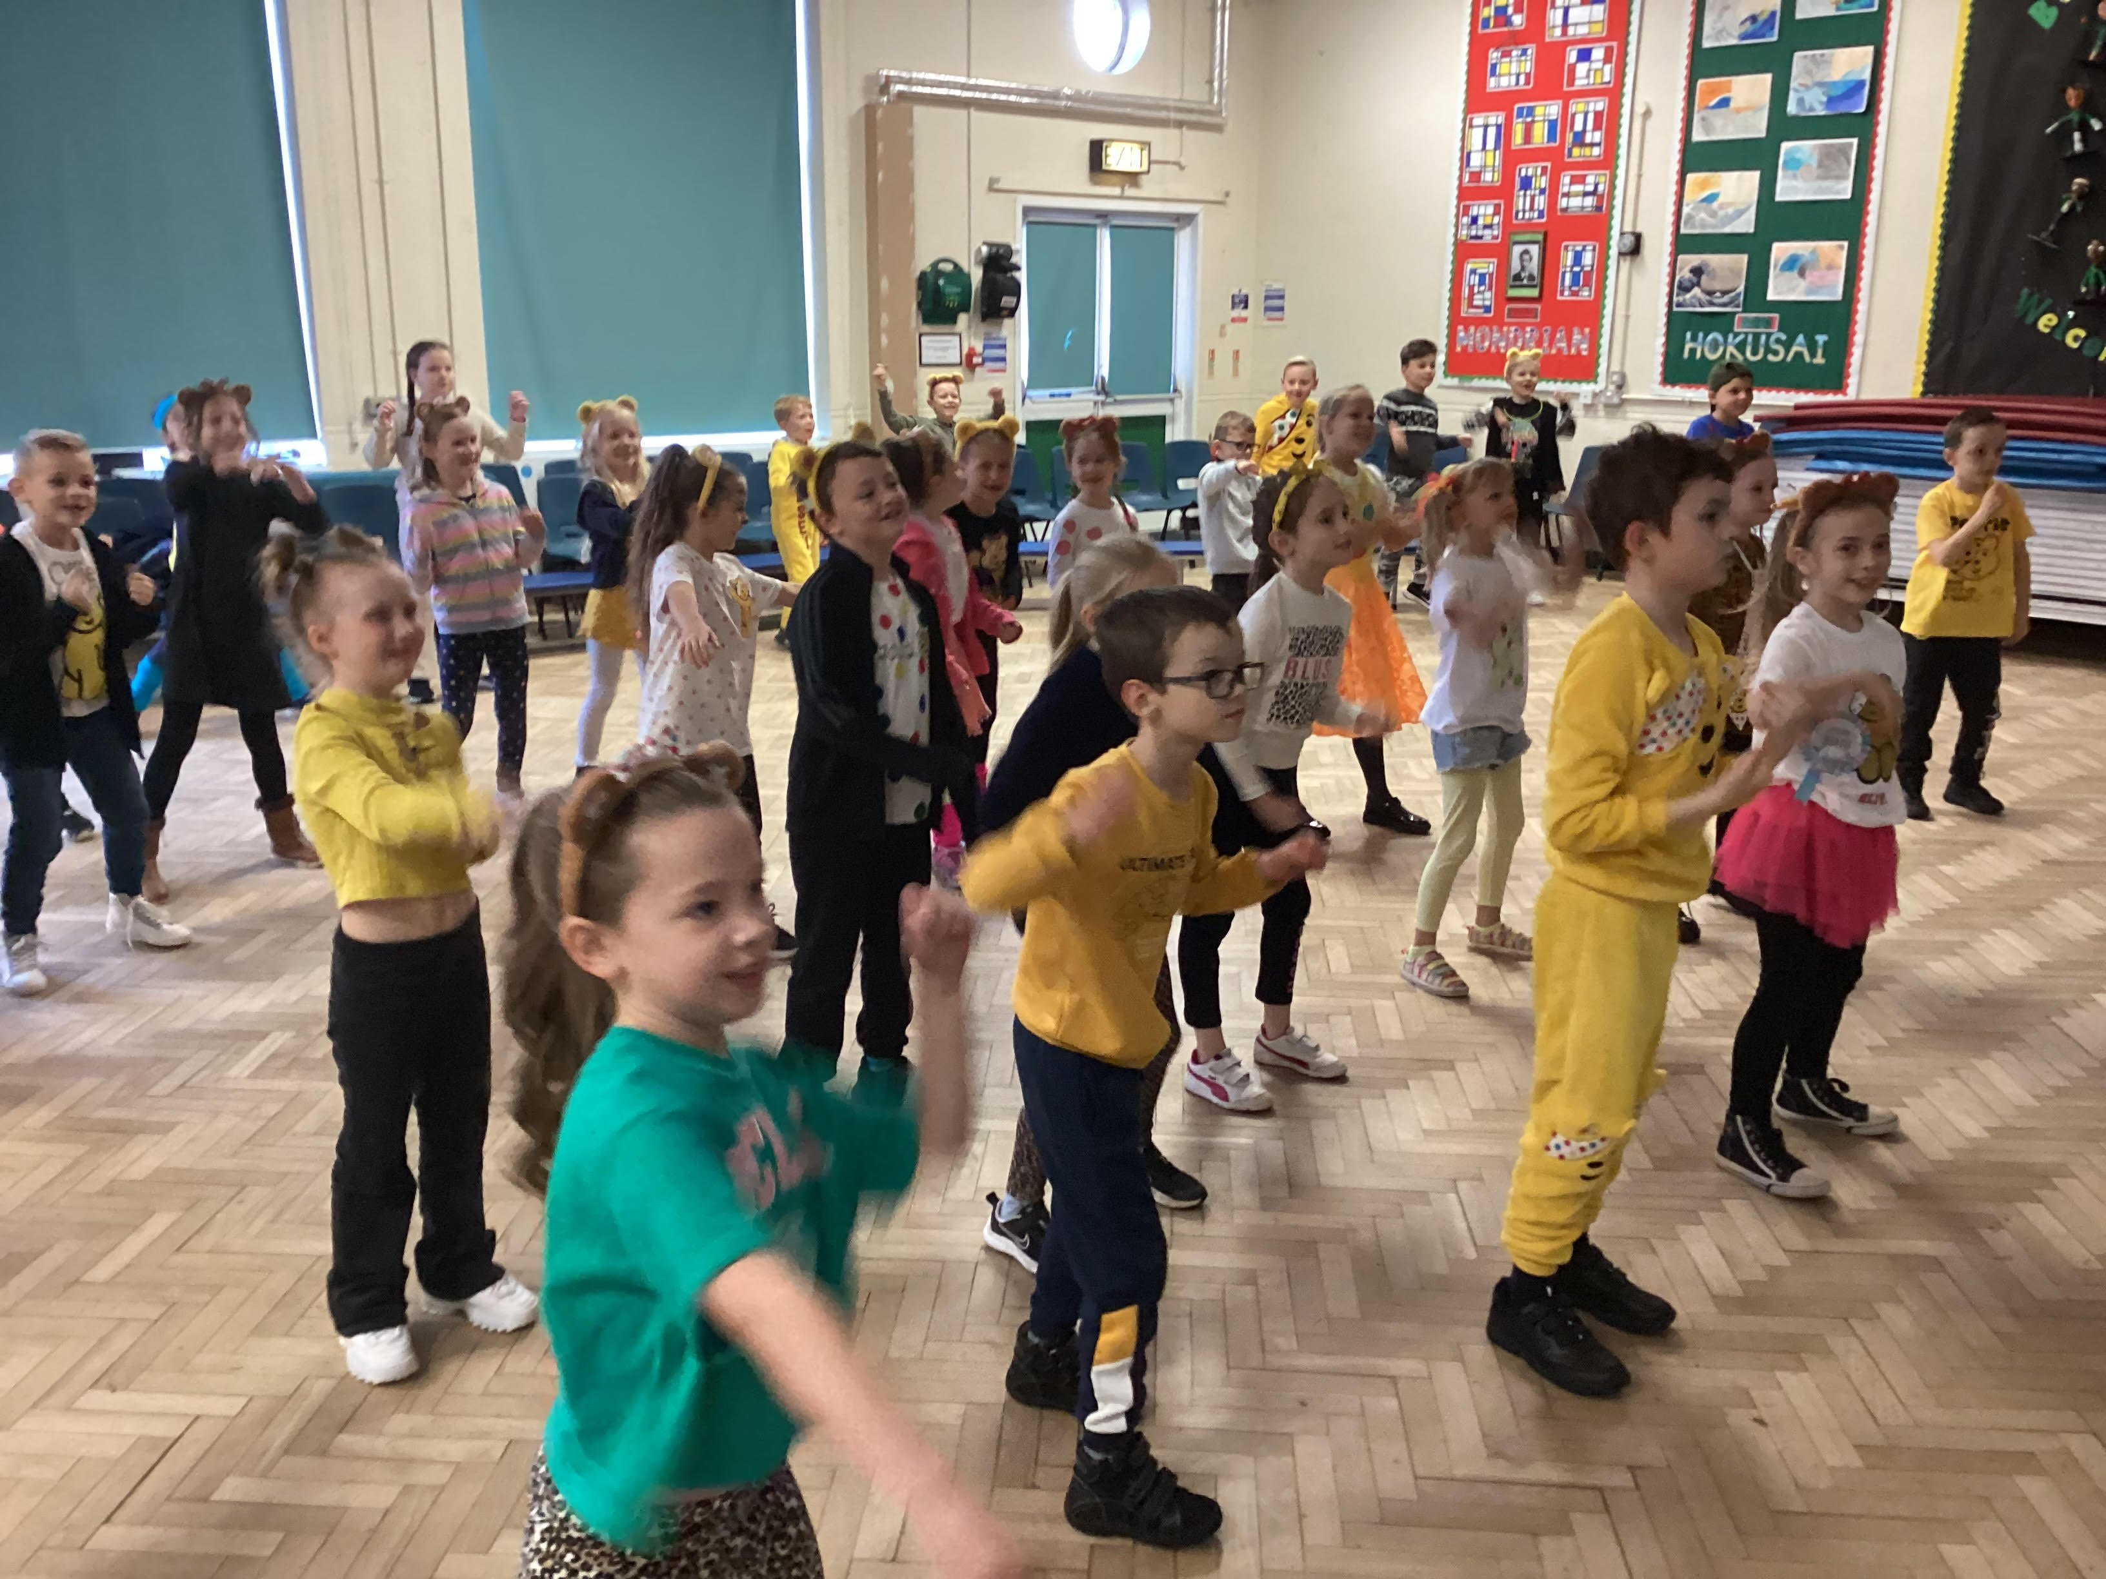
Extra-Curricular Activities, Sports and Events
Wake and Shake
830 am Tuesday, Thursday and Friday via the main entrance

Slide 13
Clubs
This year, we were awarded the School Games Gold Mark for our commitment and dedication to sports. This includes our PE provision, commitment to keeping healthy and active during the school day as well as clubs and events.
From September, Activity for All will be running a number of after school clubs. For Autumn Term, they will offer Tag Rugby, Football for Year 3/4 and Year 5/6 and Girls Squad. Girls Squad is a National Programme run by the FA to encourage girls to become more involved in sports.

Slide 14
Events and Competitions
As part of our commitment to sports, children are given the opportunity to get involved in events, tournaments and competitions outside of school.
These events cater for all abilities including non-active children, SEN children, girls as well as competitive sports such as football tournaments. This year, we have been lucky enough to take part in Futsal, Cross Country, Bowling, Quick Cricket, Tag Rugby and Football amongst others.
Children are invited to participate based on the nature of the events and its target audience via Arbor Comms.

Slide 15
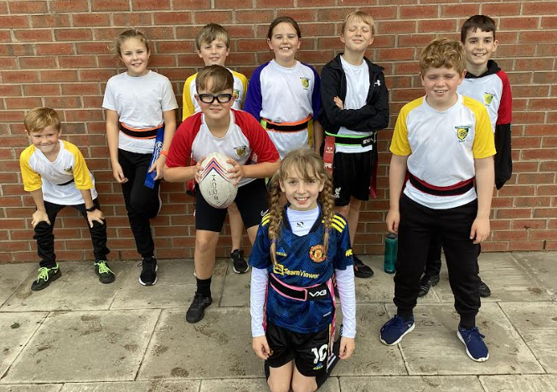
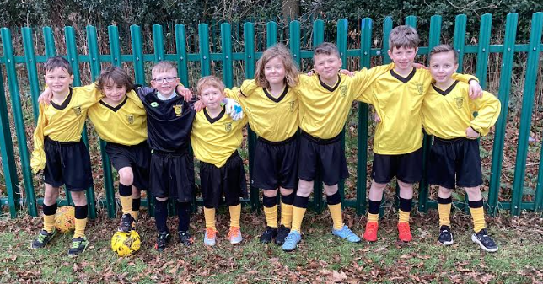
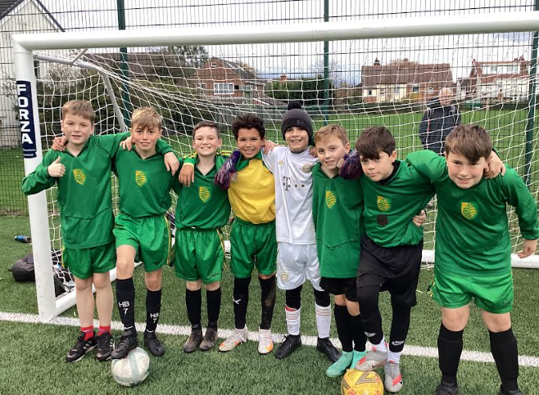
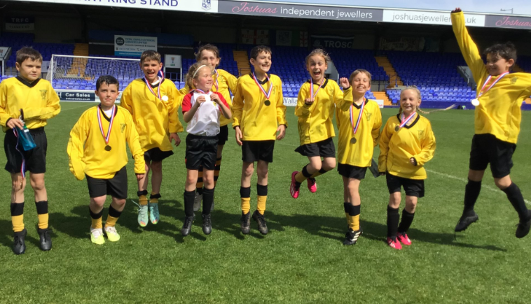
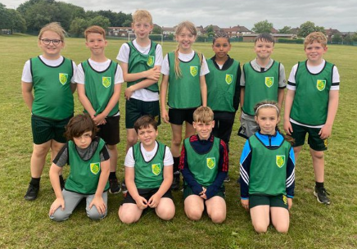

Slide 17
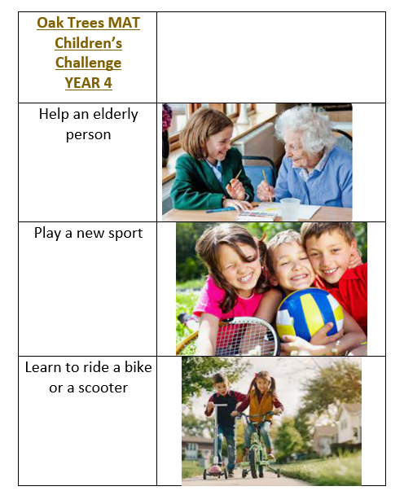
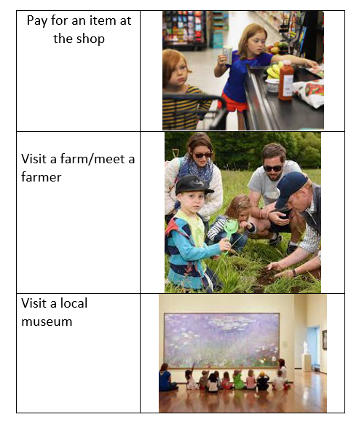
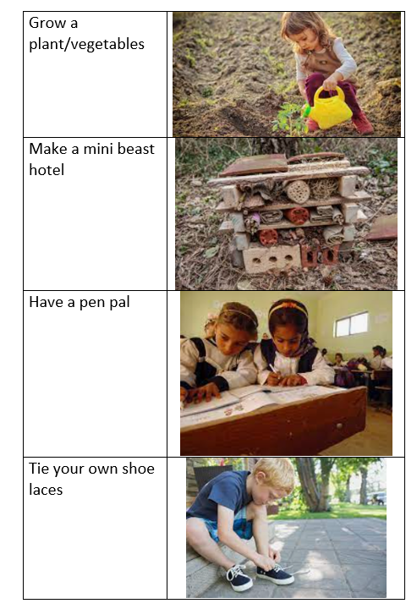
Oak Trees Challenge

Slide 18
Questions

