Slide 1
Year 4 Timestables

Slide 2
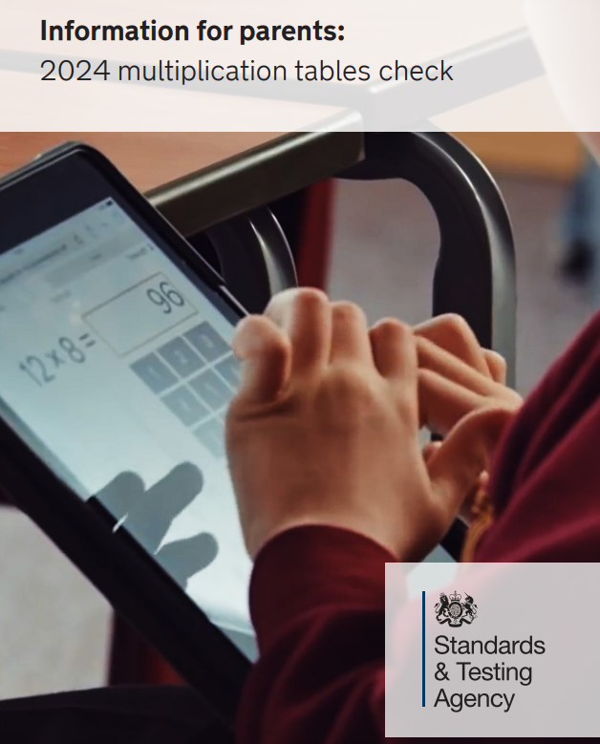
YEAR 4 MTC Check
What is it?
It is an on-screen check consisting of 25 times table questions. Your child will be able to answer 3 practice questions before taking the actual check. They will then have 6 seconds to answer each question. On average, the check should take no longer than 5 minutes to complete.
What if my child cannot access the check?
There are several access arrangements available for the check, which can be used to support pupils with specific needs. Your child’s teacher will ensure that the access arrangements are appropriate for your child before they take the check in June.

Slide 3
Why are timestables important?

Slide 4


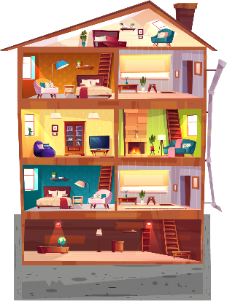
Here’s how I think about it. Imagine a big house...
Notes:
Additive relationship – watch how the shape is growing

Slide 5

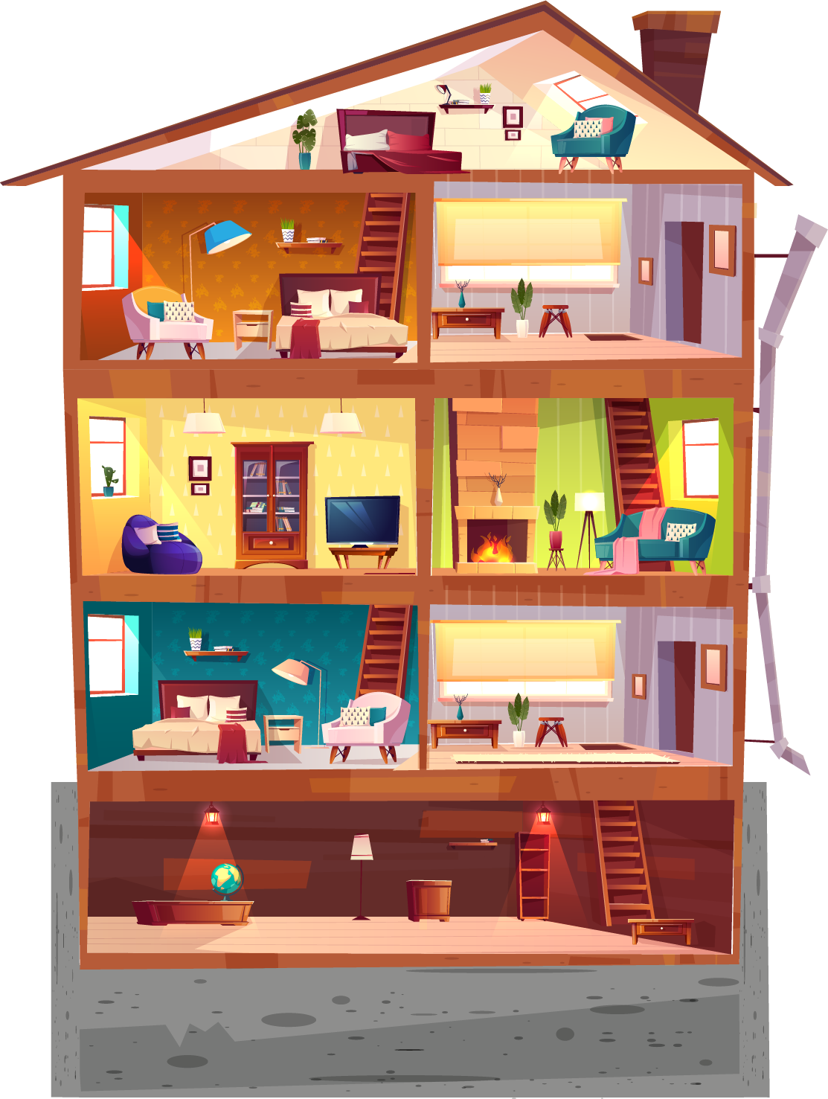

ALL THE EVEN MORE FUN STUFF
GRAPHS, SHAPES & ALGEBRA
FRACTIONS AND %
× ÷
+ −
COUNTING

Slide 6
Times tables (like adding and subtracting) need to be strong for your maths house to stay up.

Slide 7
Knowing the tables also helps you spot the right pattern.

Slide 8
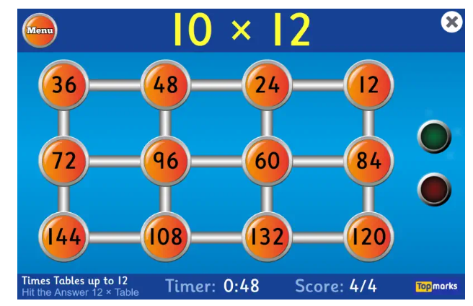
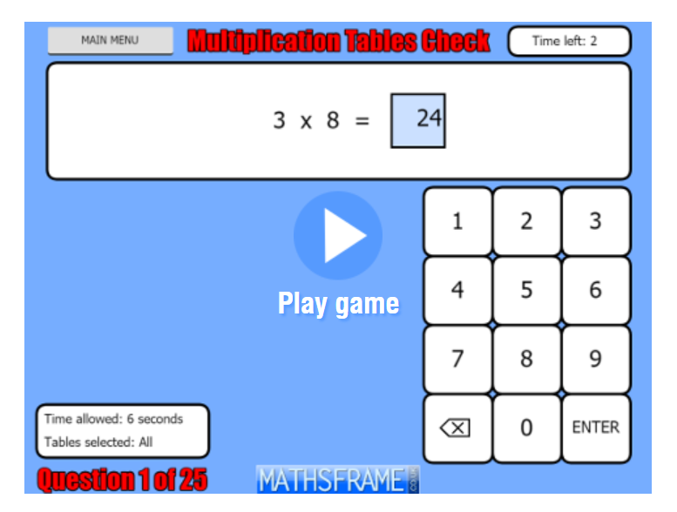

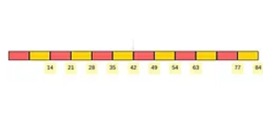
What we do in school/what can you do at home ?
Chanting
Worksheets- homework
Maths Frame- lots of different timestables games on this website
Timestable.co.uk

Slide 10
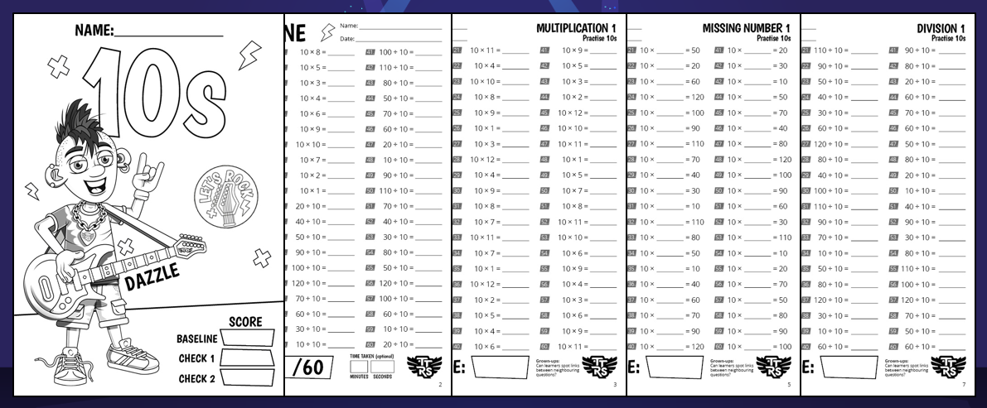
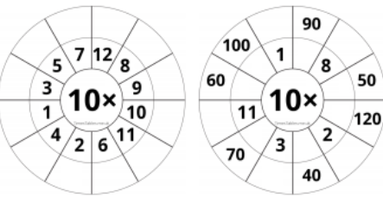
Timetable games/worksheets/testing
Bingo
Times table wheel game (played in teams)
Magic 96 (test done half termly)
Weekly testing from homework focus timestables
Timestables tennis game.

Slide 11
Times tables website links
TTRS- https://play.ttrockstars.com/
Maths frame- https://mathsframe.co.uk/
Timestables - https://www.timestables.co.uk/
Timestable me- https://www.timestables.me.uk/
Times table songs we use- https://www.bbc.co.uk/bitesize/articles/z97rdnb
Maths games - https://maths-games.org/times-tables-games.html

