Slide 1
WELCOME TO
YEAR 3

Slide 2
About me
Teaching Philosophy:
Every child is treated as an individual. I embrace/ encourage learning from mistakes, nobody is perfect. Building personal relationships are very important to success in the classroom.

Slide 3
About me continued…
I have taught for 8 years across year 1, 2, 3 and 5
I enjoy working with technology
Love to play sports and support Liverpool
I love to read, go on days out with my family and walk my dog
Enjoy exploring the world.

Slide 4
Staffing:
Teachers
Mrs Cartner & Mr Williams
Teaching assistants
Mrs Murphy-Jones and Mrs Jump

Slide 5
Staffing: Further Support
Phase leaders
Mrs Balmer
Head teacher
Mrs Fry
Pastoral
Mrs Lockett
SENCo
Mrs Balmer

Slide 6
Year Group Readiness
-Independence in getting changed for PE
-Tying shoe laces
-Remembering equipment-Reading Records, PE Kits
-Water bottles-sports cap, plastic over metal
-Children will be given school pencil cases. They can bring their own equipment
Notes:
What we expect of children in that year/what they need to be able to do and ways to help at home.
E.g.
Y3 might talk about the importance of becoming more independent and being able to get changed quickly in preparation for their swimming lessons. You might also talk about the Times Tables Test in Y4 and how they can start to help prepare their children while they are in Y3.

Slide 7
Daily Routines
8.30am-Wake and Shake open to all in the hall via Main Entrance Monday, Tuesday, Thursday and Friday
8.45am-9am Registration and Morning Activities
Assembly or Handwriting
Morning of English, Maths and Reading
Break-A healthy snack can be brought in from home or purchased from canteen
Year 3 and 4 will have a separate break time at 11am
Lunch 12.15pm -Quiet Club, Play Leaders for Year 3 games Sports Ambassadors lead a variety of playground activities along with a Sports Coach
Quiet Club -accessible for children who struggle during unstructured times
Afternoons -children will access a ‘brain break’ outside when weather permits.
Notes:
Explain that children will be discouraged from accessing their water bottles during teacher inputs.

Slide 8
Our Curriculum
Notes:
Explain that this may be subject to change.

Slide 9
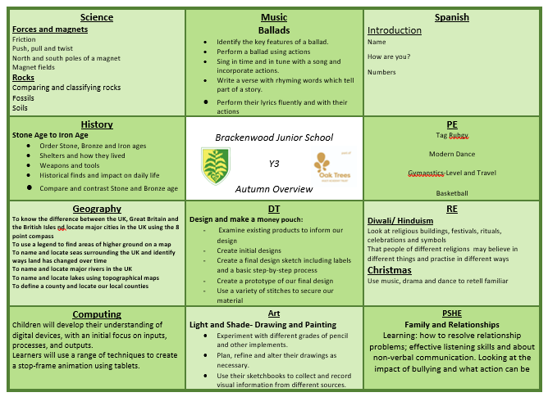
Our Curriculum
Notes:
Explain that this may be subject to change.

Slide 10
Assessment
Reading
Children will be assessed within the first few weeks to determine their reading ages and phonics ability.
From this, children will be given reading books appropriate to their ability. Extra support may be given for children who require further phonics support through RWI and interventions.
Termly Assessments
Allows us to monitor progress and adapt our teaching for future lessons to ensure gaps. Children are then identified if further support is required. These are fed back through Parents Evenings.

Slide 11
Oak Trees Challenge

Slide 12
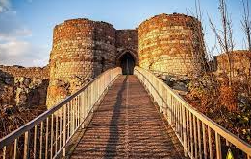
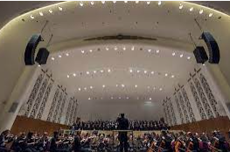
Trips and Visits
Autumn Term-History Stone Age to Iron Age
Spring Term-Philharmonic Liverpool
Summer Term –Liverpool World Museum

Slide 13
PE Days
Children will bring their PE kits in to be kept in school. Year 3 will have PE on a Monday and Tuesday.
Kit-black/green shorts with BJS top or a plain white t-shirt. Plain jogging bottoms/leggings may be required for outdoor PE on colder days. Children can wear their school cardigans/jumpers on these days as a extra layer.

Slide 14
Communication
Arbor Comms
Twitter
Open evenings
Email/call/come in to speak to staff - teacher, phase leaders, headteacher
Parents evenings
Reports
Support Plans for SEND
Coffee mornings
Parent surveys
Staff on gates
Certificates
Message home
Week ahead
Weekly news

Slide 15
Homework/ parental support
Homework expectations – under development following the Homework survey
Reading - phonics
Parent reading volunteers (can sign up in the hall)
Parent helpers
Twitter etc (can sign up in the hall with AS)
Parent Gov vacancy (will be advertised in Sept)

Slide 16
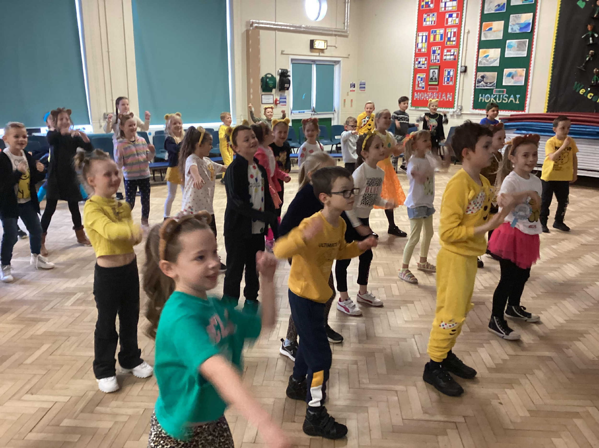
Extra-Curricular Activities, Sports and Events
Wake and Shake
8.30 am Tuesday, Thursday and Friday via the main entrance

Slide 17
Extra-Curricular Activities, Sports and Events
Clubs
This year, we were awarded the School Games Gold Mark for our commitment and dedication to sports. This includes our PE provision, commitment to keeping healthy and active during the school day as well as clubs and events.
From September, Activity for All will be running a number of after school clubs. For Autumn Term, they will offer Tag Rugby, Football for Year 3/4 and Year 5/6 and Girls Squad. Girls Squad is a National Programme run by the FA to encourage girls to become more involved in sports.

Slide 18
Extra-Curricular Activities, Sports and Events
Events and Competitions
As part of our commitment to sports, children are given the opportunity to get involved in events, tournaments and competitions outside of school.
These events cater for all abilities including non-active children, SEN children, girls as well as competitive sports such as football tournaments. This year, we have been lucky enough to take part in Futsal, Cross Country, Bowling, Quick Cricket, Tag Rugby and Football amongst others.
Children are invited to participate based on the nature of the events and its target audience via Arbor Comms.

Slide 19
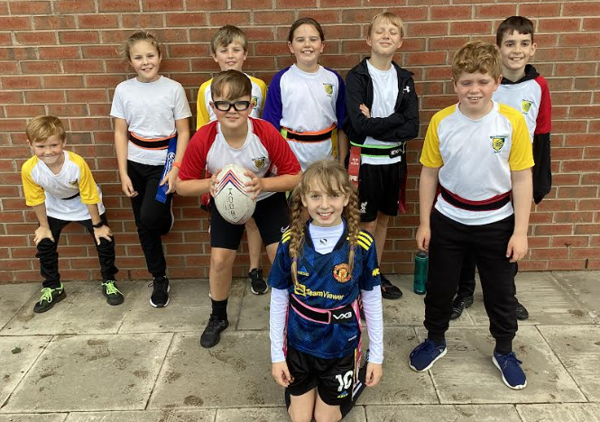
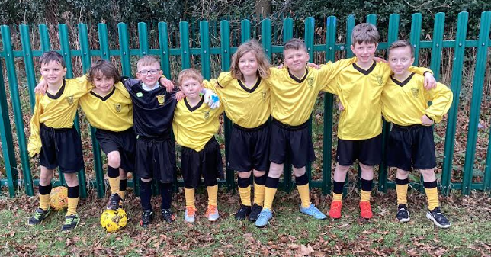
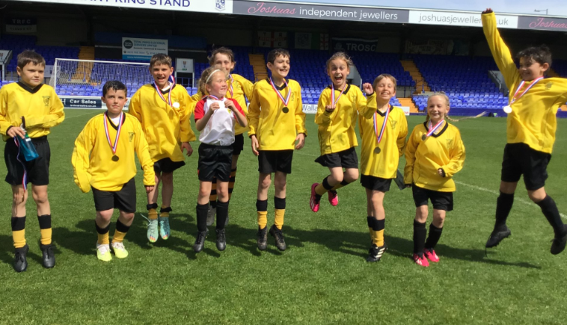
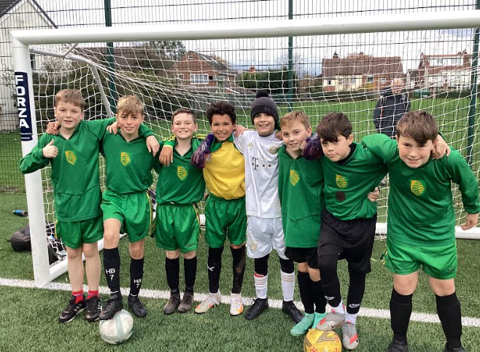
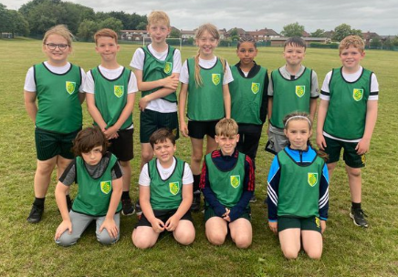

Slide 20
Questions

